Slide 1

device exploitation:
Utilizing Metasploit and msfvenom
Eric Ledesma

Slide 2

Tools and Components used:
Kali Linux Attack Machine
msfvenom
Metasploit
Keytool, Jarsigner, Zipalign
An Android A01 Phone

Slide 3

Tools and Components:
Keytool is a key and certificate management utility. It allows users to administer their own public/private key pairs and associated certificates for use in self-authentication (where the user authenticates himself/herself to other users/services) or data integrity and authentication services, using digital signatures.
Keytool

Slide 4

Tools and Components:
The jarsigner tool uses Keystore information to create or verify Java ARchive (JAR) digital signatures. (A JAR file packages in single file class files, pictures, sounds, and/or other digital data). The jarsigner checks the digital signature of a JAR file, by using its supplier certificate (included in the JAR file’s signature block), and checks whether or not it contains a “trustworthy” public key of a JAR file, that is, in the designated Keystore.
Jarsigner

Slide 5

Tools and Components:
Zipalign is a zip archive alignment tool. It ensures that all uncompressed files in the archive are aligned relative to the start of the file. This allows those files to be accessed directly via mmap(2) , removing the need to copy this data in RAM and reducing your app's memory usage.
Zipalign

Slide 6

Tools and Components:
The Metasploit Framework is an open source platform that supports vulnerability research, exploit development, and the creation of custom security tools.
Metasploit

Slide 7

Tools and Components:
Msfvenom is a command line instance of Metasploit that is used to generate and output all of the various types of shell code that are available in Metasploit.
msfvenom

Slide 8

What is a .apk file?
An APK file is an app created for Android!
It needs a signature created by a keytool and “verified” by a jarsigner.

Slide 9
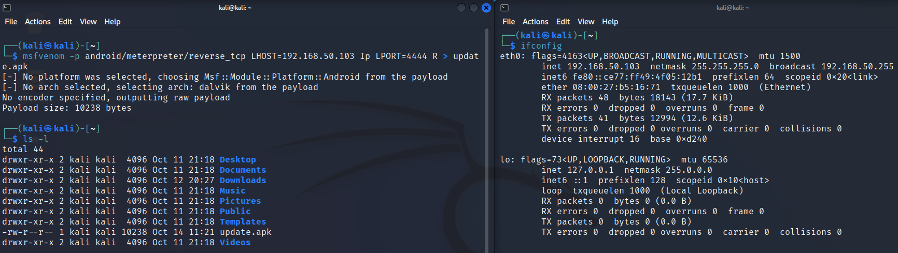
Step 1: Creating a Malicious Payload

Slide 10
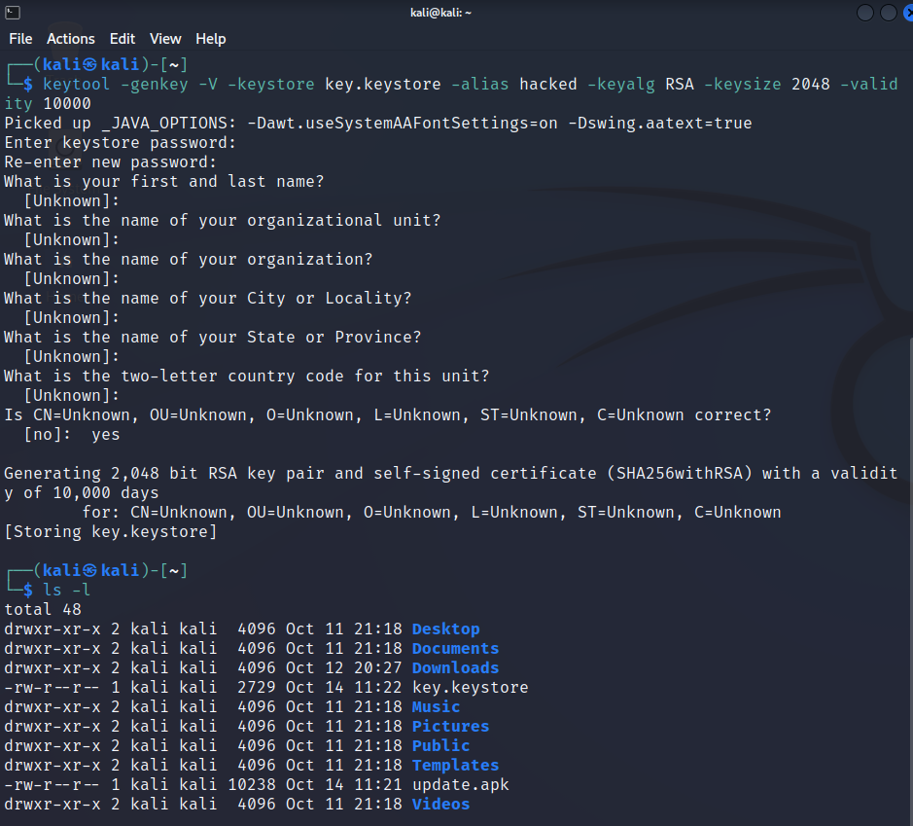
Step 2: Signing the Certificate
Creating a keytool for a self-signature
Keytool is preinstalled with Java

Slide 11
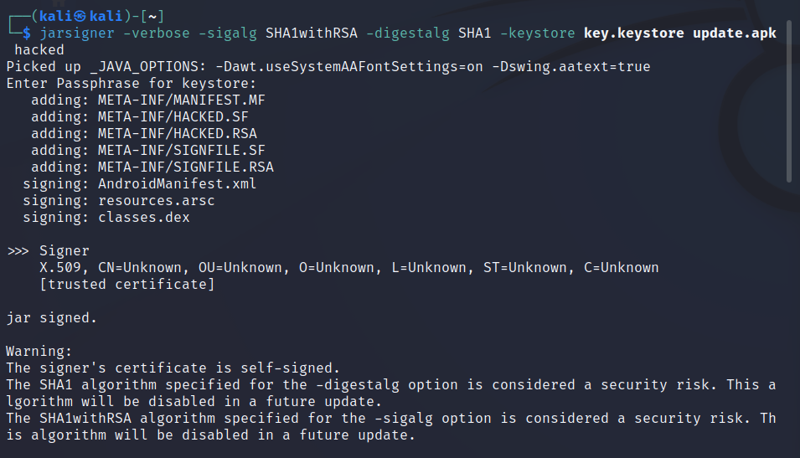
Step 2: continued
Self-signing the .apk file.
$apt-get install openjdk-11-jdk

Slide 12
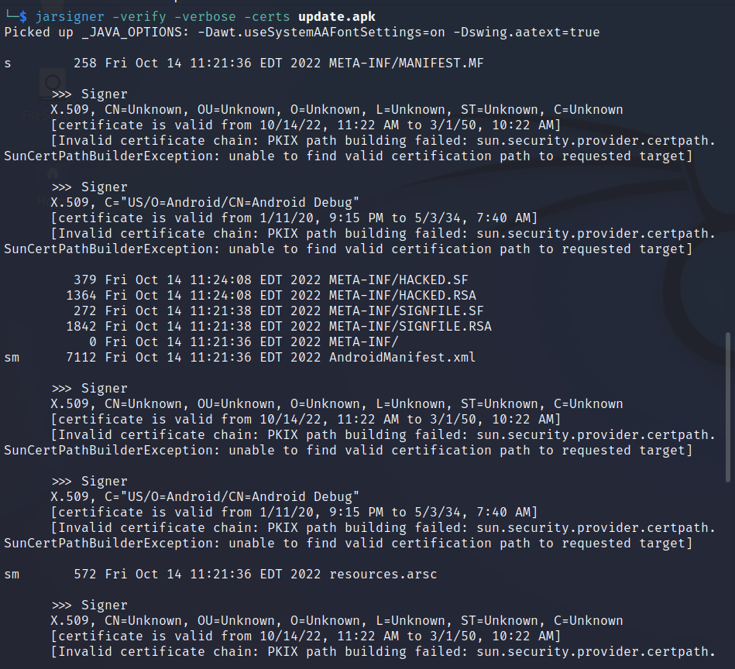
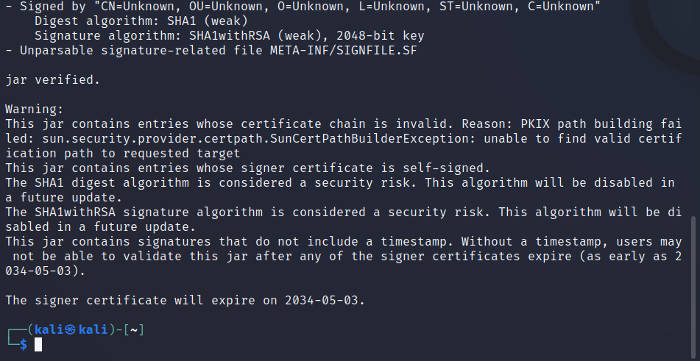
Step 2: continued
Verifying the signature.

Slide 13
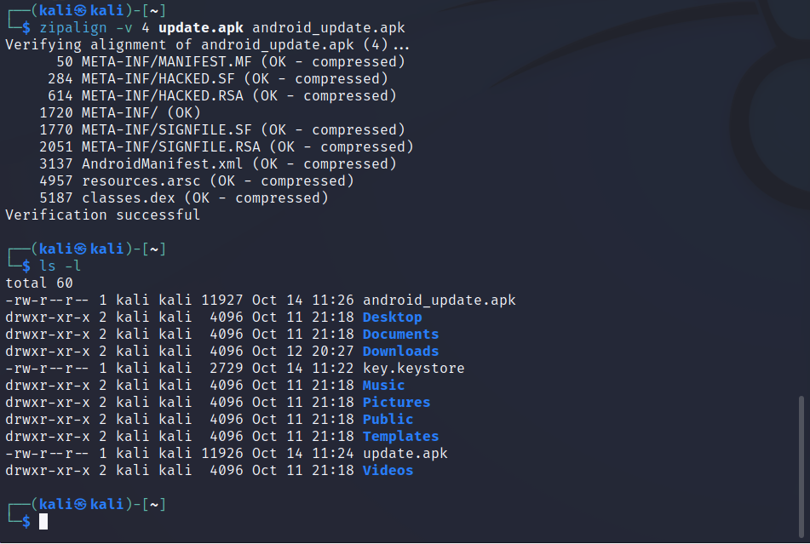
Step 3
Finally, using zipalign, this will assure that the data in the .apk file is optimized, and will enable the Android OS to interact with the app efficiently.
$sudo apt-get install zipalign

Slide 14
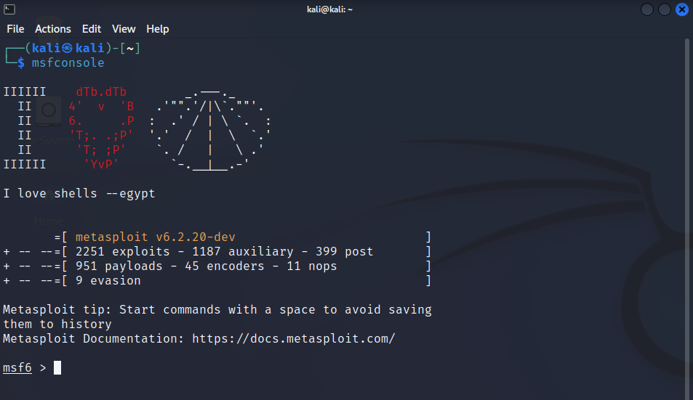
Step 4: Setting up a Listener Port on Metasploit

Slide 15
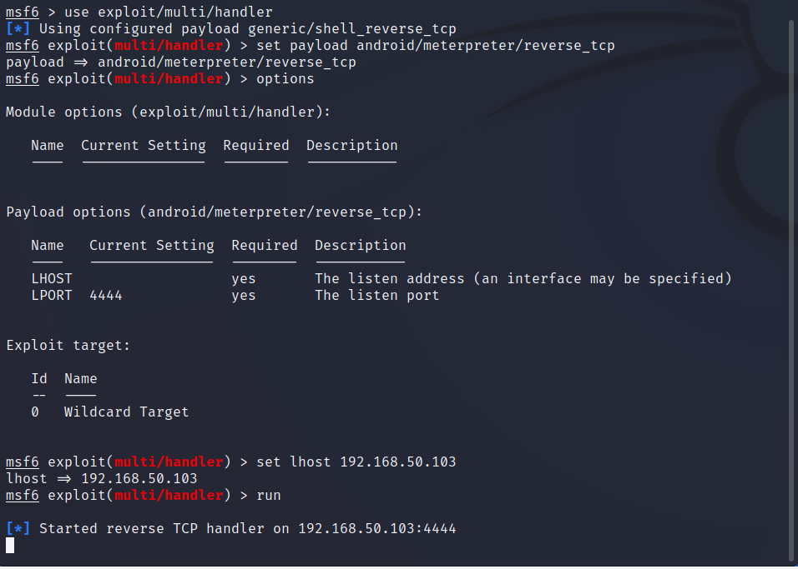
Step 4: Metasploit continued

Slide 16
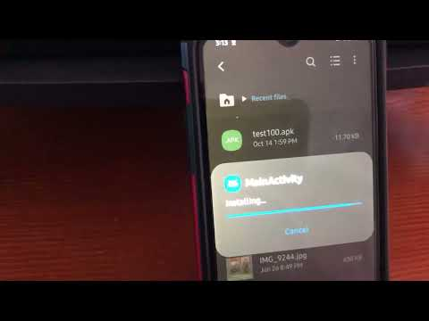
Step 4: Metasploit continued
and…

Slide 17
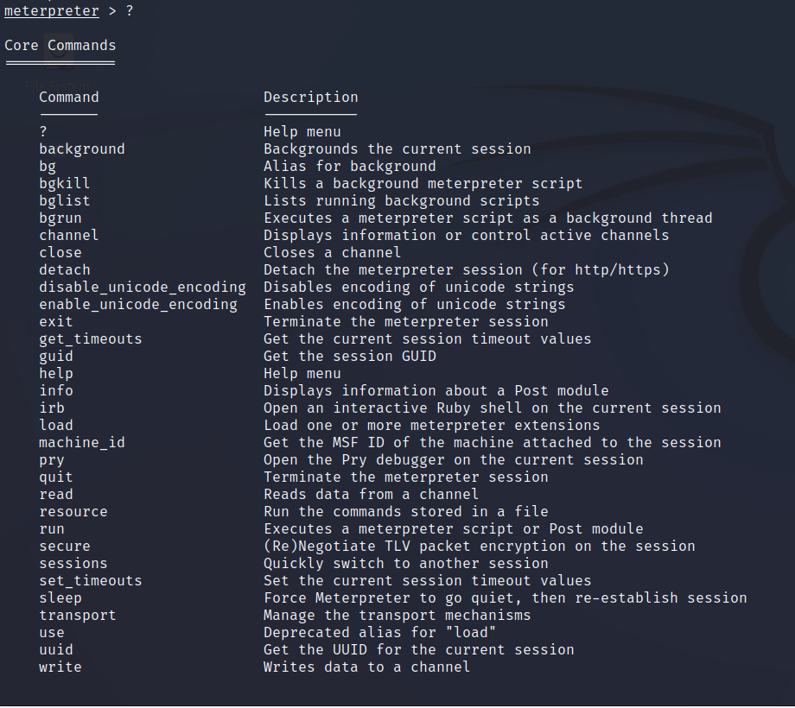
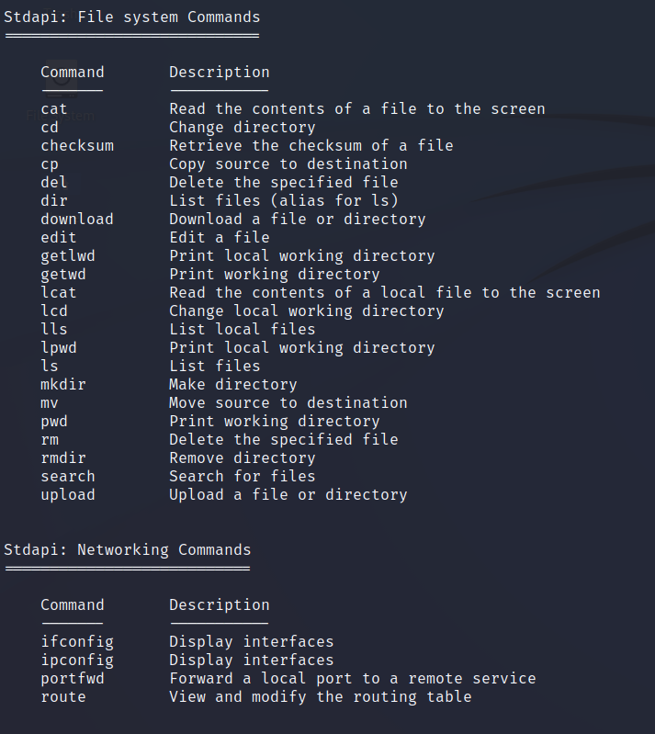
…I’m in!

Slide 18
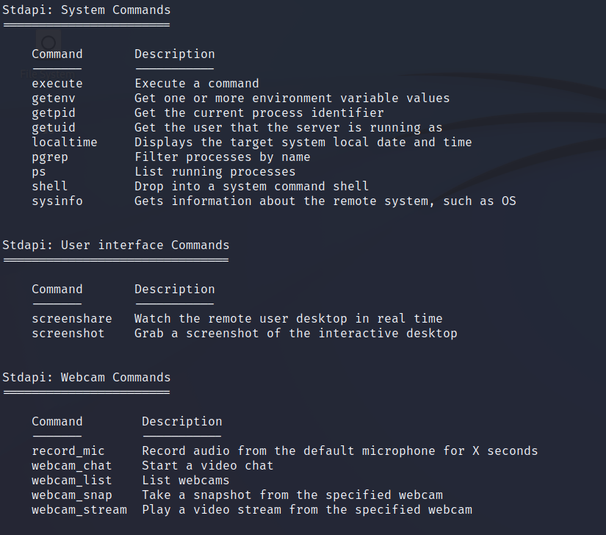
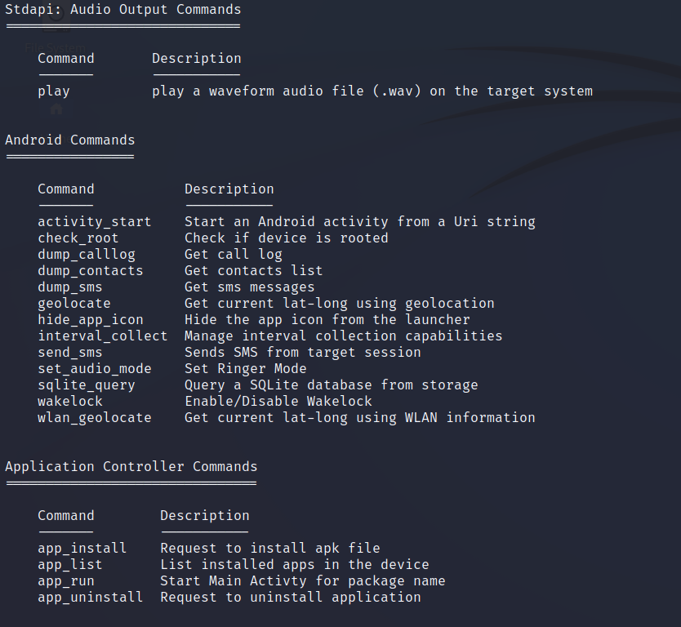
Commands of Interest:

Slide 19
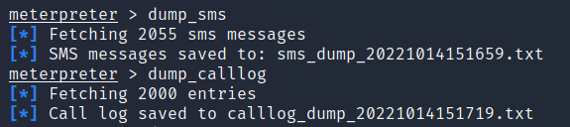
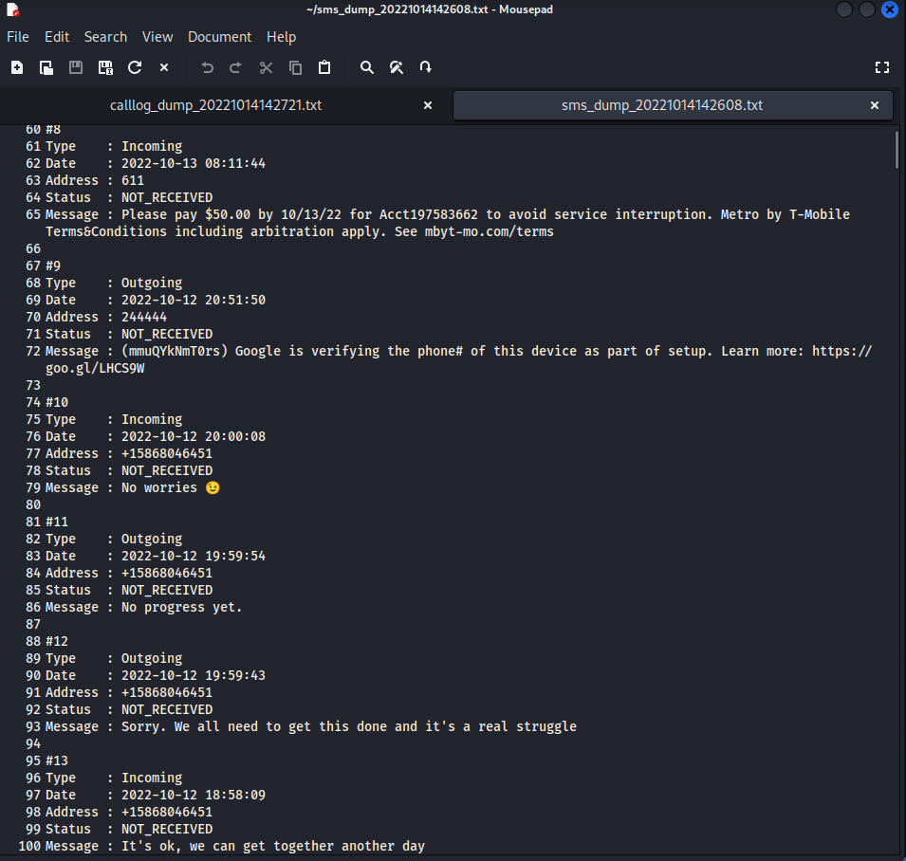
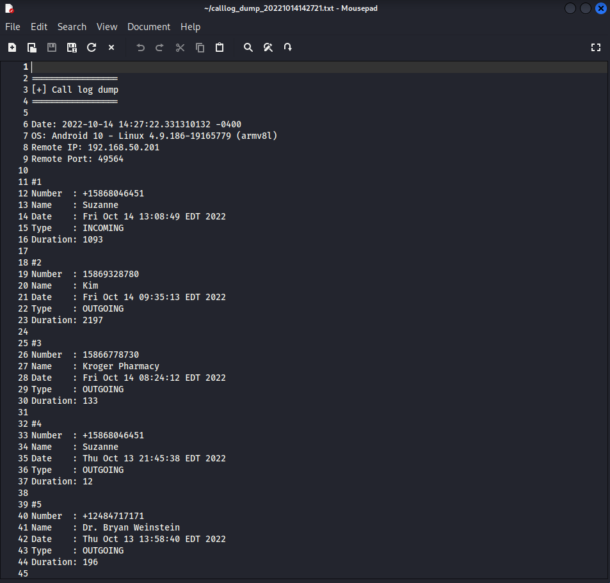
Using dump_sms and dump_calllog commands to dump sms and call logs into my linux home folder.

Slide 20
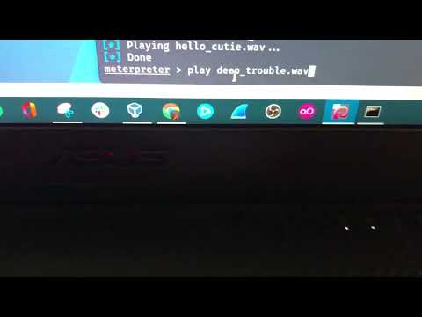
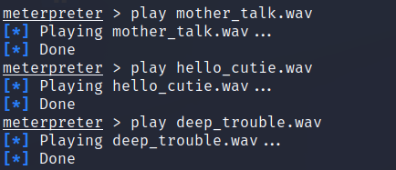
Playing some .wav files through meterpreter.

Slide 21
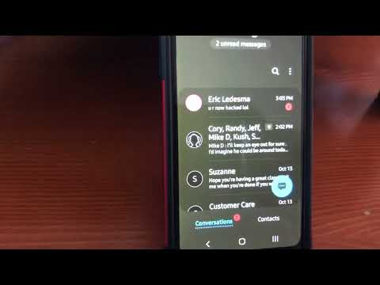

Sending myself a SMS through meterpreter.

Slide 22
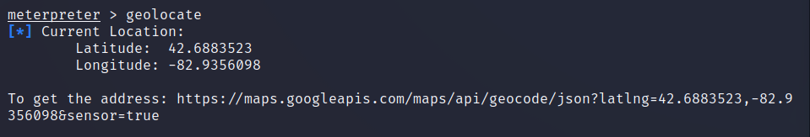
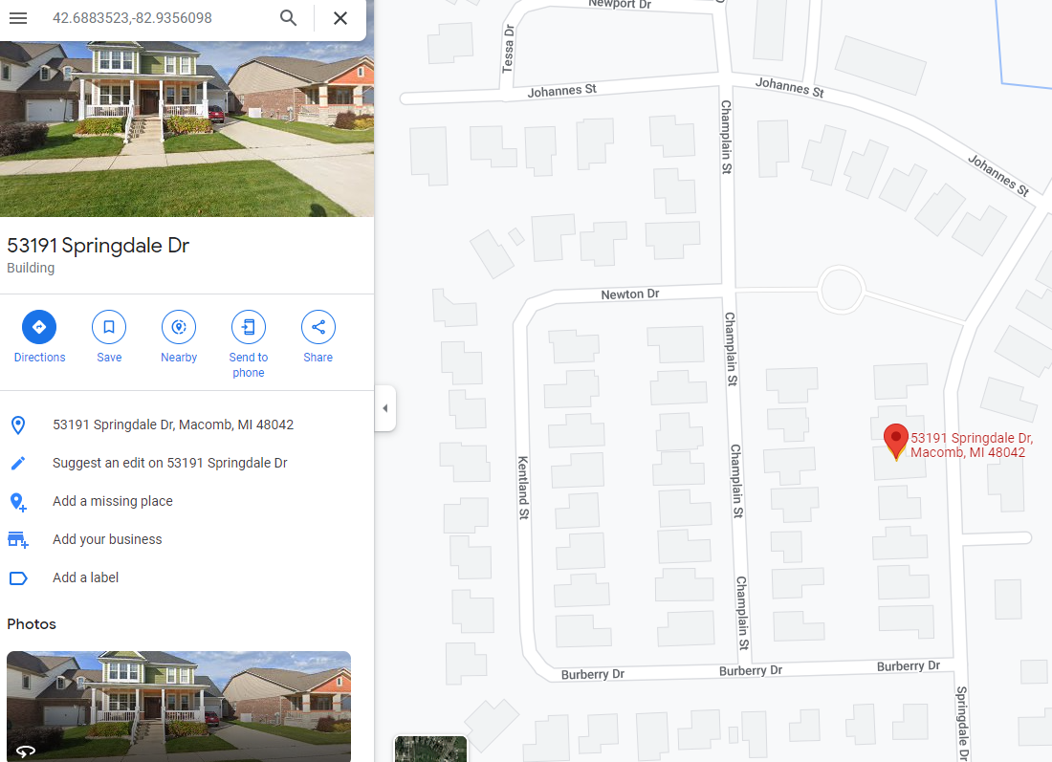
A geolocate command to find the Android’s exact coordinates…

Slide 23
Final Words
The initial plan was to use Metasploit for phone access. Overcoming difficulties with emulators and multiple attempts, I eventually succeeded in exploiting my own Android device with the .apk file.

Slide 24
Thanks for Watching!
Questions?

